Slide 1

Rules for Using
Chromebooks

Slide 2

1. Always sit down while using the Chromebooks.

Slide 3

2. If you are asked to move for any reason, carry the Chromebook with two hands and hold the Chromebook by the base, not the cover.

Slide 4


3. No banging, slamming, or hitting the Chromebook.

Slide 5

4. Stay focused on the activity, and raise your hand if you need help.

Slide 6
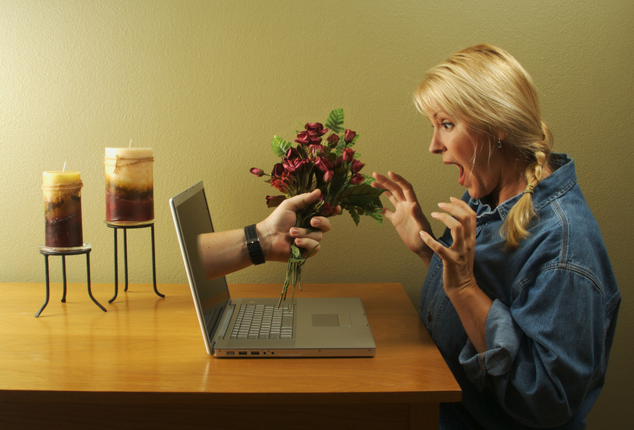
5. Do not visit pages that are not directly related to your assignment.

Slide 7

5. Do not touch someone else’s Chromebook.

Slide 8

7. No gum, food, or drinks allowed.

Slide 9

8. Stop when directed and shut down before closing the Chromebook.

Slide 10
The Rules are…
1. Always sit down while using the Chromebooks.
2. If you are asked to move for any reason, carry the Chromebook with two hands and hold the Chromebook by the base, not the cover.
3. No banging, slamming, or hitting the Chromebook.
4. Stay focused on the activity, and raise your hand if you need help.
5. Do not visit pages that are not directly related to your assignment.
6. Do not touch someone else’s Chromebook.
7. No gum, food, or drinks allowed.
8. Stop when directed and shut down before closing the Chromebook.

Slide 11

Thank you for downloading my FREE Chromebooks Rules. I hope that you enjoy the resource and get a lot of use out of it. Please let me know if you have any questions or concerns. My email address is happyedug8r@msn.com.
Commercial Graphics used with permission from the following: Microsoft Design, GraphicStock.com
For more teaching ideas and freebies, please click on the link to visit my blog! http://www.happyedugator.blogspot.com Also, I would love to have you follow me on Facebook. https://www.facebook.com/TheHappyEdugator.
Look for me on Google +, Twitter, and Linked-In! Please leave feedback at My TPT Store. Click on the green star to follow me for freebies and sales.
http://www.teacherspayteachers.com/Store/HappyEdugator Remember, you will earn credits for leaving me feedback which goes toward any future TPT purchases. Thank you and happy teaching!
Deborah Hayes
aka HappyEdugator

